Slide 1

Fintech Credit Card Risk Data Analysis and Recommendations
Aaron Packard, Mark Foxworth, Alex Waters

Slide 2
Motivation and Summary
Overview of Credit Card originations and insight as to how economic factors influence the risks associated with Credit Card lending.
The intent of this analysis was to utilize available data to
forecast expected unemployment rates over the subsequent 12 month period
estimate future credit card charge offs based on forecasted unemployment rate via linear regression
make a lending recommendation based on a financial institutions acceptable risk tolerance (acceptable charge off rate).

Slide 3

Questions of the data:
What is the relationship between age, neighborhood income level, and credit scores compared to credit card origination volume?
What is the relationship between prime rate, personal savings rate, and unemployment rate to credit card delinquency rates and credit card charge off rates?
Based on the current economic environment and historical impacts on the credit card market, should an organization adopt measures to increase card originations or should card originations be reduced?

Slide 4


Data Sources:

Slide 5
Data Exploration and Clean Up
Packages:
Cleanup:
Pandas
PyViz
Plotly Express
Pathlib
Dotenv
Quandle-API
Hvplot
SkLearn
Panel
API pulls from Quandl (FED Data)
CSV files retrieved from CFPB
Pulled Data into Python
Merged data into filtered data frames
Droped null values
Used resample.mean to fill required fields on quarterly and monthly data

Slide 6

Discussion of Findings

Slide 7
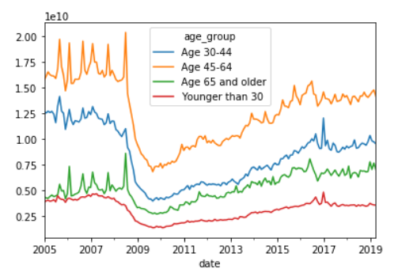
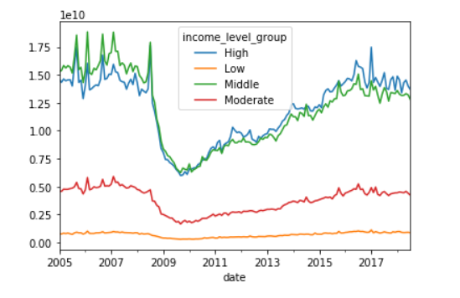
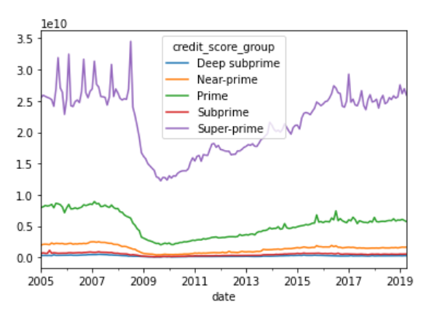
Credit Card Origination DATA (CFPB)
Age Demographics:
Income level:
Credit Tier:

Slide 8
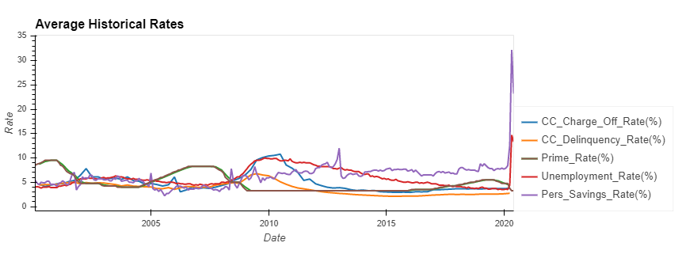
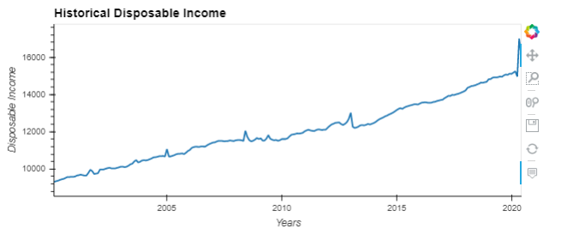
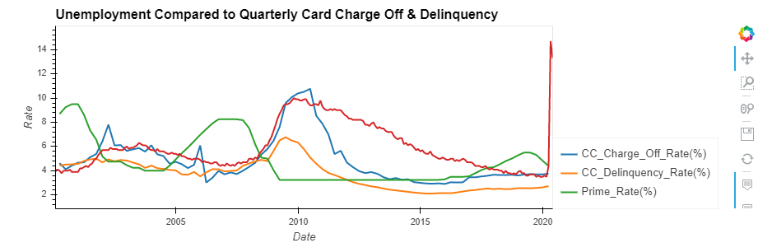
Economic data (FED):

Slide 9
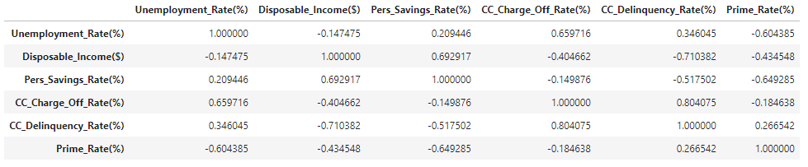
Correlations:

Slide 10
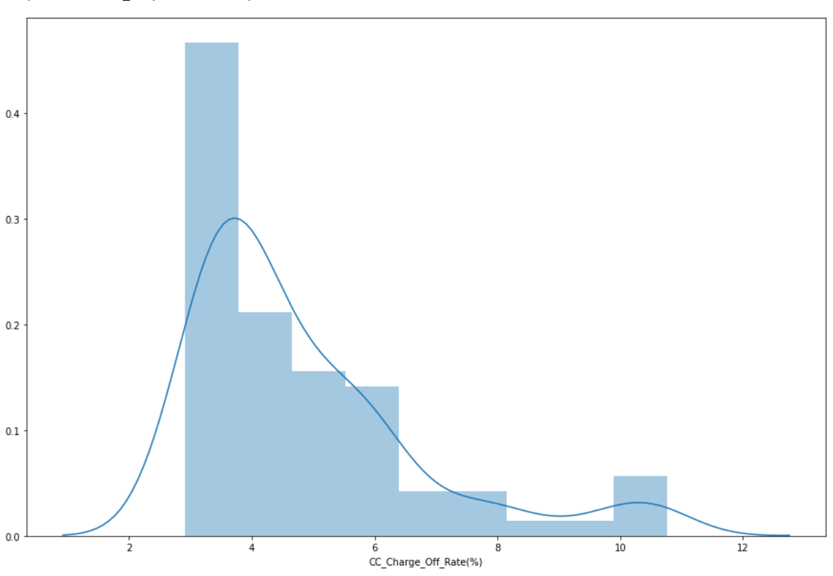
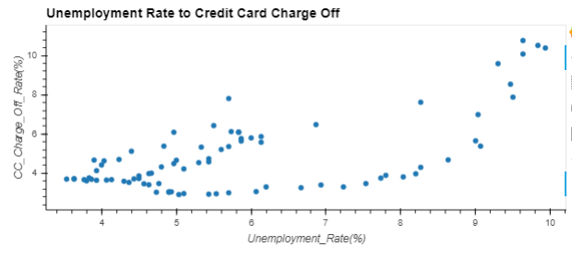
Confirming Linear Regression is appropriate
Charge Off Distribution
Unemployment / Charge-Off Plot

Slide 11
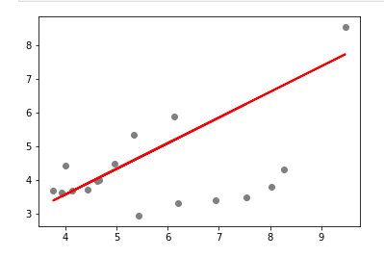
Linear Regression Analysis

Slide 12
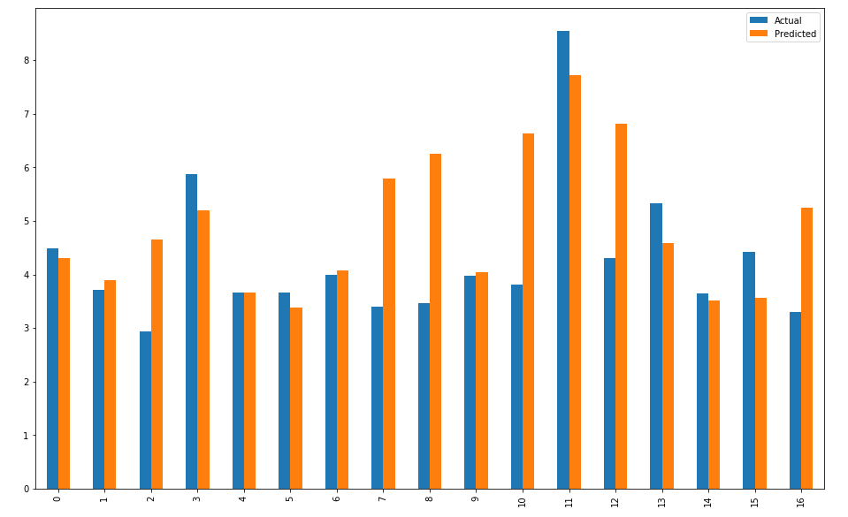
ACTUAL VS PREDICTED CHARGE OFF RATE

Slide 13
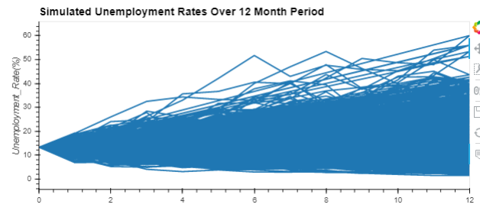
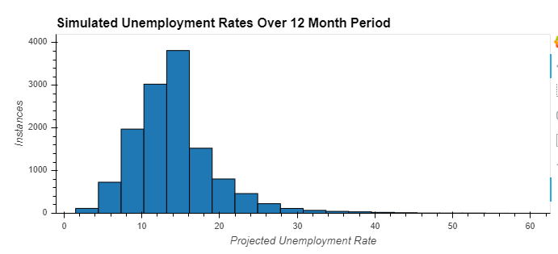
Monte Carlo Analysis: Forecasted Unemployment
Unemployment rate confidence interval
0.05 = 6.85
0.95 = 24.5

Slide 14


Slide 15
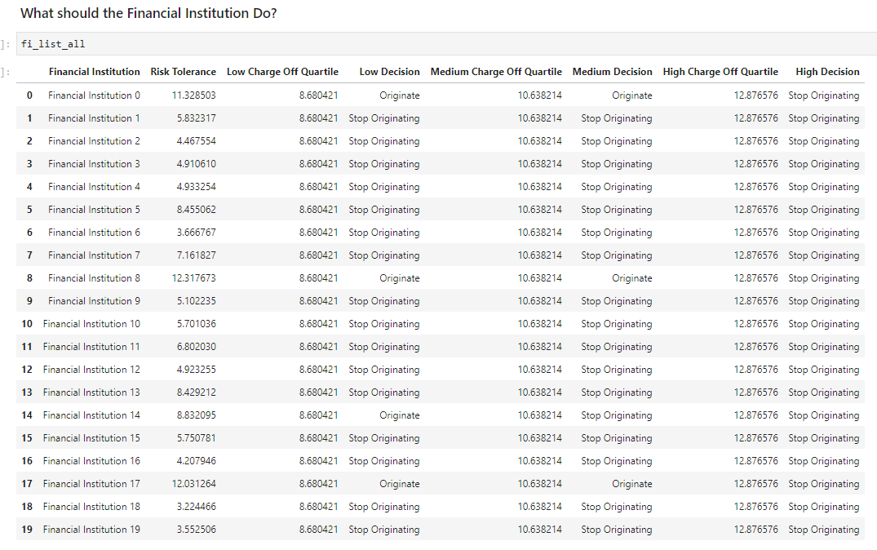

Slide 16
Wrap up issues and outstanding questions
We recognize that there is a delay when charge off and unemployment. Credit Card must be delinquent first before charge off.
Historical loan data was not analyzed to accurately to determine financial institution risk tolerance
Geographic locations where not considered(eg. Unemployment in local regions)

Slide 17

ANY

